Slide 1

Crop Recommendation and Prediction System
By
Sarang Bahikar(22106129)
Krishit Doshi(22106001)
Project Guide
Mr. Viki Tukaram Patil

Slide 2
Outline
Introduction
Literature Survey of the Existing Systems
Limitations of the Existing Systems
Problem Statement
Proposed System Design
Framework/Algorithm
Technologies Stack for Proposed System
Details of Database / Input to the System
Implementation(Partial)
Conclusion
References

Slide 3
Introduction
Agriculture is the backbone of many economies, and efficient farming practices are essential for ensuring food security and sustainable development.
In recent years, the application of data-driven solutions in agriculture has gained momentum, providing farmers with tools to improve crop productivity and make better decisions.

Slide 4
Introduction
One such innovation is the Crop Recommendation and Prediction System, a project designed to assist farmers in selecting optimal crops based on environmental factors and predicting yields or challenges that might arise during cultivation.

Slide 5
###Literature Survey of the existing system
Assael, Y., Shillingford, B., & de Freitas, N. (2016). LipNet:End-to-End Sentence-Level Lipreading. arXiv preprint arXiv:1608.04496. -History and basic idea
Gergen, J., et al. (2016). A Study of Word-Level Lip Reading Accuracy. Proceedings of the IEEE Conference on Computer Vision and Pattern Recognition (CVPR).
-Dataset and Performance Evaluation
Chung, J. S., & Zisserman, A. (2016a). Lip Reading in the Wild. Proceedings of the IEEE Conference on Computer Vision and Pattern Recognition (CVPR).
-Trend And Scope

Slide 6
###Limitations of Existing Systems
Ambiguity in Lip Movements: Many sounds look similar on the lips, leading to confusion and misinterpretation.
Lack of Context: Lip reading lacks the vocal intonation and pitch that provide context, making it hard to understand emotional tone or intent.
Language Variability: Different languages and dialects have unique lip patterns, making it hard for a lip reader to adapt across languages.

Slide 7
Problem statement
Agriculture, a critical sector for food production and economic sustainability, faces numerous challenges that impact crop yield and productivity.
Farmers often struggle to make informed decisions about which crops to plant due to complex factors such as varying soil conditions, unpredictable weather patterns, and changing market demands.

Slide 8
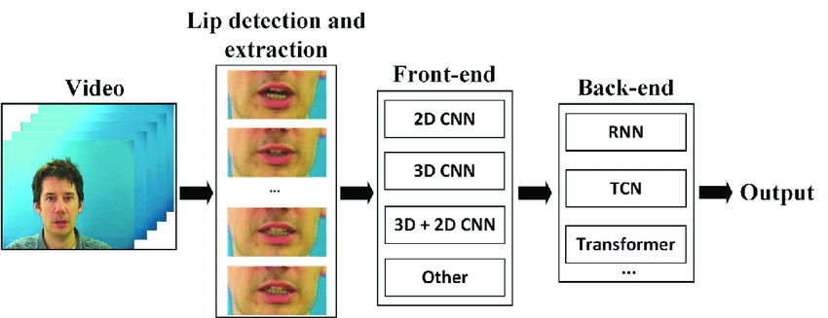
###Proposed System Design###

Slide 9
###Framework/Algorithm
Deep learning lipreading process: Firstly, the lip region is located and extracted from the video, then the temporal and spatial features are extracted by the front-end, and finally, these features are used as input to the back-end and are concatenated at each time step for classification.
This is the standard Convolution Neural Network which was first introduced in Lenet-5 architecture. Conv2D is generally used on Image data.
Conv3D is mostly used with 3D image data. Such as Magnetic Resonance Imaging (MRI) data.

Slide 10
###Technology Stack for Proposed System
Data Collection: Gather and annotate a diverse video dataset with lip movements and corresponding text.
Pre-processing: Detect and isolate the lip region using
face detection and landmark techniques, and normalize
the video data.
Feature Extraction: Extract key features from the lip
region using methods like Optical Flow, CNNs, or
3D CNNs to capture both spatial and temporal aspects.

Slide 11
###Details of Database / Input to the System
LRS2 (Lip Reading Sentences 2)
Description: LRS2 is a large-scale dataset consisting of thousands of sentences from over 100,000 spoken words taken from BBC television shows. It provides diverse real-world scenarios, making it suitable for training models on complex and varied lip movements.
Use Case: Suitable for building more generalizable and robust lip reading systems that can handle real-world variability.

Slide 12
###Implementation(Screenshots of implementation : 50%)

Slide 13
Conclusion
The development and deployment of Crop Recommendation and Prediction Systems represent a significant leap forward in modern agriculture, enabling farmers to make more informed, data-driven decisions that optimize crop yields and resource use.
By leveraging advancements in machine learning, big data, and remote sensing, these systems provide accurate, timely crop recommendations based on environmental factors such as soil properties, weather conditions, and historical crop data.

Slide 14
References
Chung, J.S., Senior, A.W., Vinyals, O., & Zisserman, A. (2017). Lip Reading Sentences in the Wild. IEEE Conference on Computer Vision and Pattern Recognition (CVPR).
Assael, Y.M., Shillingford, B., Whiteson, S., & de Freitas, N. (2016). LipNet: Sentence-level Lipreading. arXiv preprint arXiv:1611.01599.
Zhao, G., & Barnard, M. (2009). Lipreading Using Spatiotemporal Templates. IEEE Transactions on Pattern Analysis and Machine Intelligence.

Slide 15
Thank You...!!

